Slide 1
GENDER EQUITY IN CHIRURGIA BARIATRICA
R.D. BERTA
CHIRURGIA BARIATRICA IV
IRCCS Policlinico San Donato, MI

Slide 2
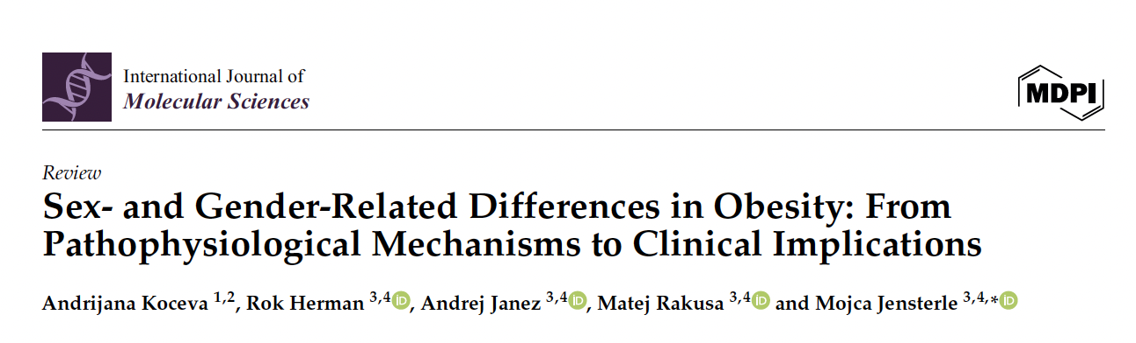
Are
Male and Female
Obesity the same disease ?

Slide 3
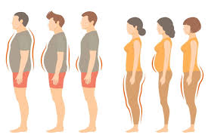

Sex and
Gender-Specific
Differences
Body Composition and Fat Distribution
Energy Expenditure
Roles of Sex Steroid Hormones
Genetic Susceptibility
Gut Microbiota

Slide 4

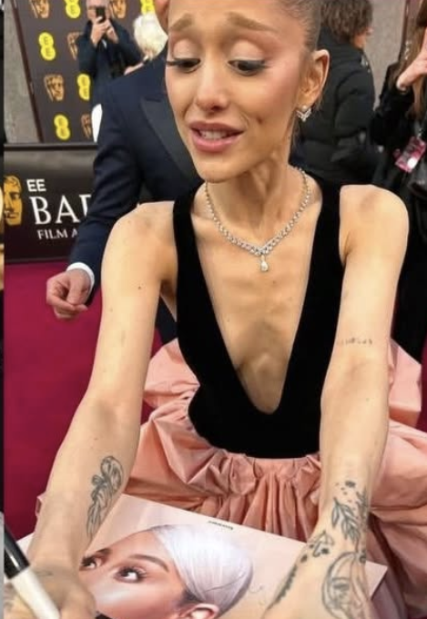
Sex and Gender-Specific
Risk Factors
Influencing Obesity Pathology
Behavioural Neuroadaptive Food Intake Preferences
Sociocultural Role Modelling
Gender-Specific Psychological Influence

Slide 5
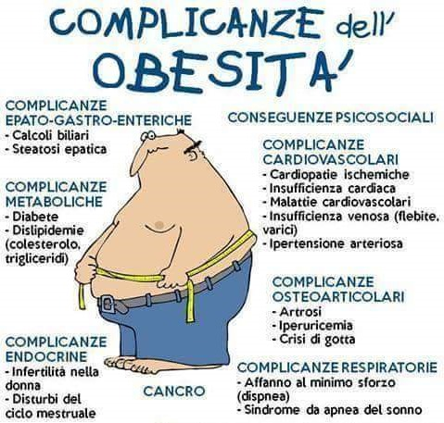
Clinical Implications of Sex and Gender-Related Differences in Obesity
Differential Risks of Obesity-Related Comorbidities

Slide 6
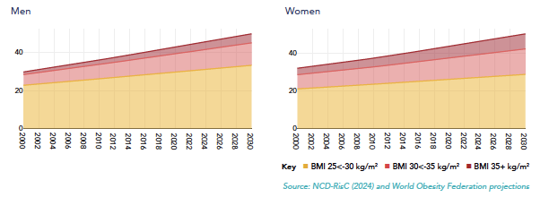

Global Trend
of high BMI
in adults
23%
27%
23%
Men | BMI > 35 | All High BMI
2015 | 3% | 39%
2030 | 5% | 50%
Women | BMI > 35 | All High BMI
2015 | 5% | 40%
2030 | 8% | 50%

Slide 7

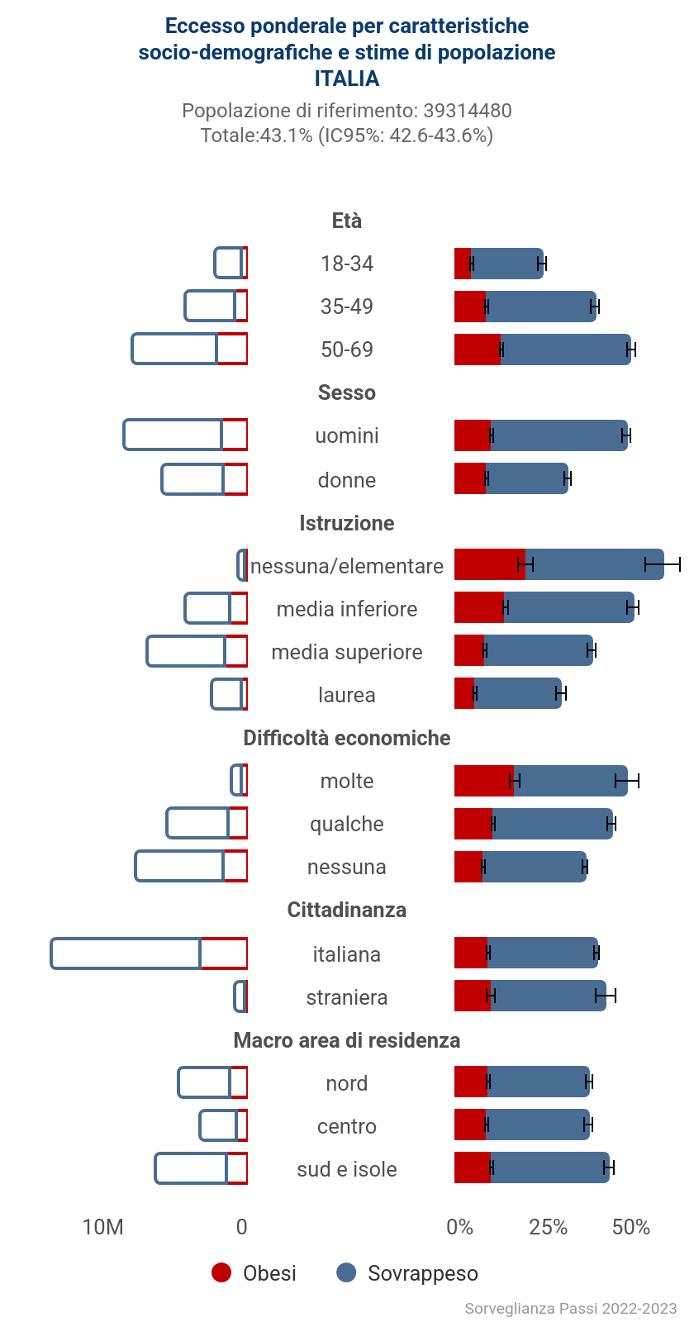
Italian Trend
of high BMI
in adults
♀
♂

Slide 8
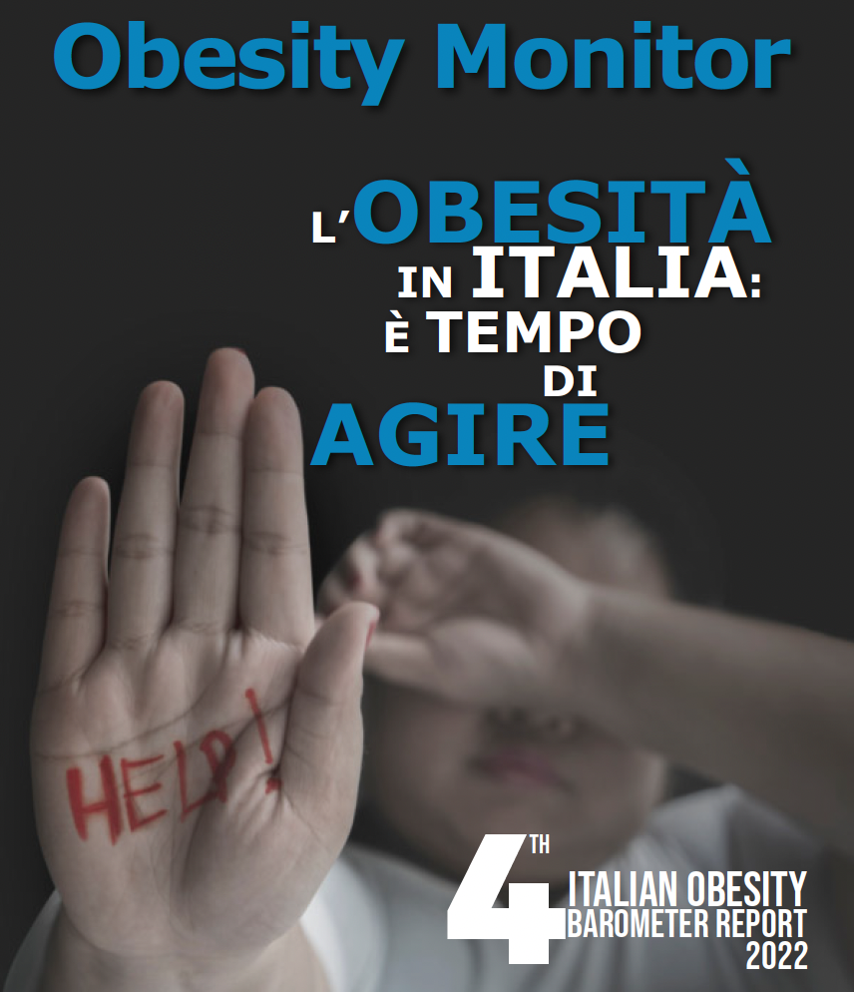
Italian Trend
of high BMI
in adults
Italian Barometer
Obesity Report 2022.

Slide 9
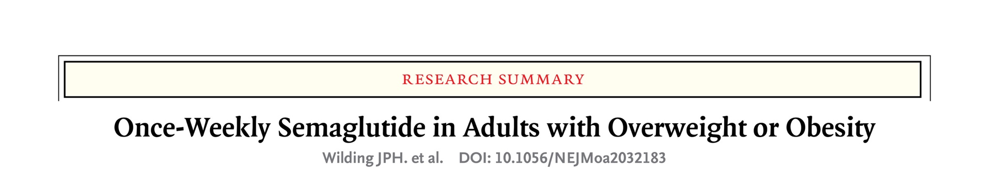
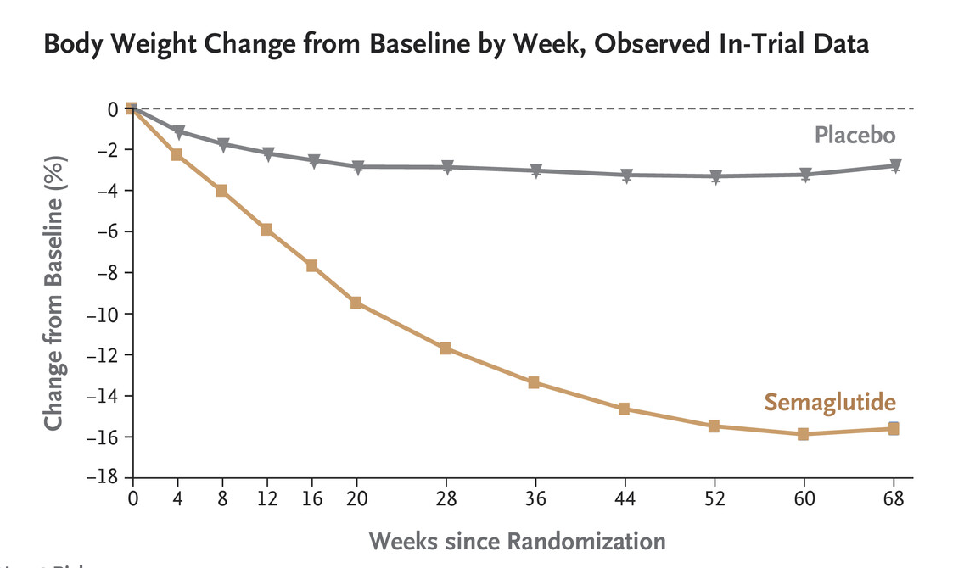

Sex and Gender-Related Differential Effectiveness of Weight Loss Interventions
GLP 1 ANALOGUES
sex differences in the response to GLP-1 and its analogs as well as an interaction of these therapeutics with estrogens. Females
also had a 32% higher drug exposure than males of similar body weight and achieved
greater weight loss at any given exposure compared to males [

Slide 10
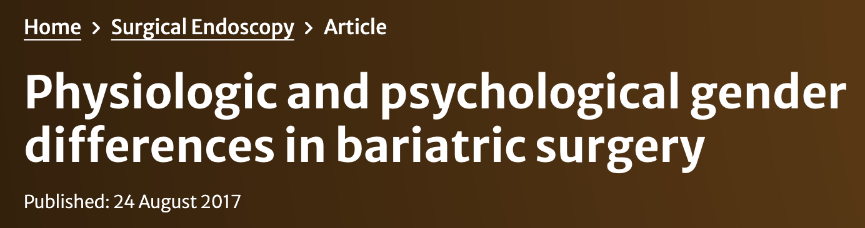
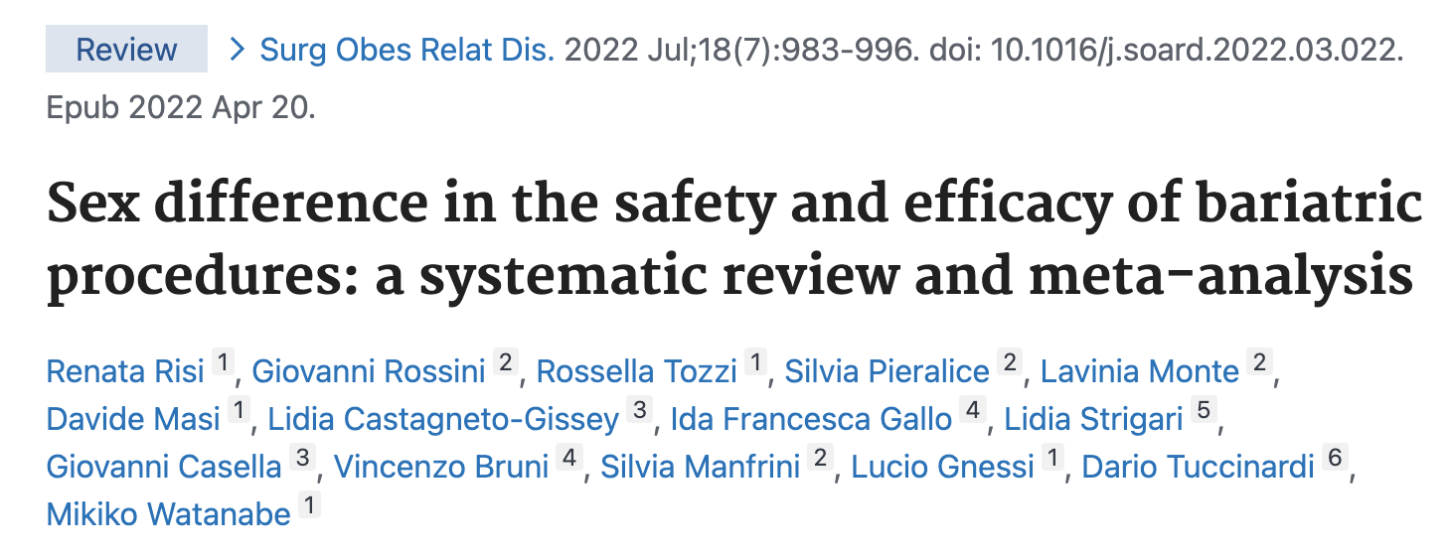

Sex and Gender-Related Differential Effectiveness of Weight Loss Interventions
BARIATRIC SURGERY
REGISTRO SICOB
F 105.879 BMI 42,98
M 35.908 BMI 44,81

Slide 11

Sex and Gender-Related Differential Effectiveness of Weight Loss Interventions
BARIATRIC SURGERY
MEN were more likely to achieve greater BMIL, consistent with higher male baseline BMI
WOMEN were 2.87 times more likely to be classified as weight responders
WOMEN perform better in terms of %EWL
NO SEX DIFFERENCE regarding COMORBIDITY RESOLUTION (hypertension, diabetes, and obstructive sleep apnea syndrome) or occurrence of short-term complications
more postoperative complications in men

Slide 12
Gender Difference
in Surgical Outcomes
BARIATRIC SURGERY

Slide 13
Gender Difference
in Surgical Outcomes
BARIATRIC SURGERY

Slide 14
Gender Difference
in Surgical Outcomes

Slide 15


Gender Difference
in Surgical Outcomes

Slide 16
Gender Difference
in Surgical Outcomes

Slide 17
Gender Difference
in Surgical Outcomes
BARIATRIC SURGERY

Slide 19
CONCLUSIONS
There is a clear sexual dimorphism in obesity prevalence,
There is huge disparity in access to weight loss Interventions,
A sex-specific analysis is often missing
Overcoming Stigma barriers and further research on sex and gender-related differences across different treatment modalities is needed to ensure optimized and personalized obesity management.

Slide 20
Grazie

